Slide 1
Unshakable Kingdom
Unshakable Worship
Heb.12:26-29

Slide 2
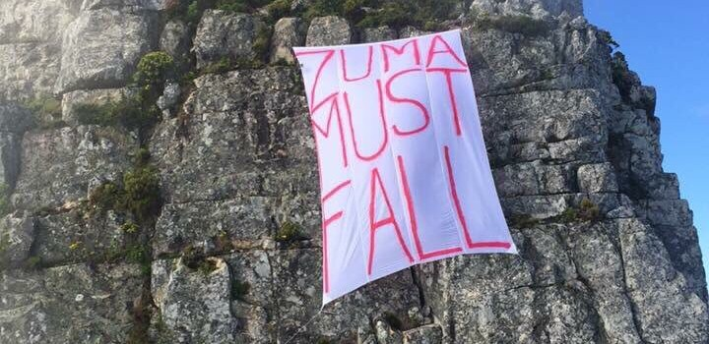
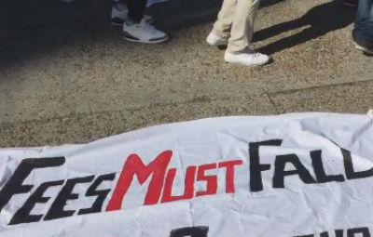
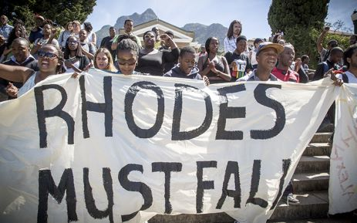

Slide 3
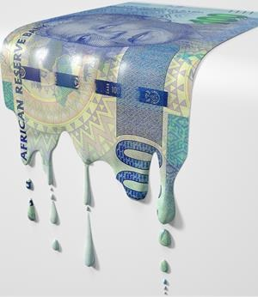

Slide 4
Heb. 12:26-29
Destyds het God se stem van Sinaiberg af die aarde geskud. Maar nou kondig Hy aan: “Nog een keer sal Ek nie net die aarde laat bewe nie, maar ook die hemel.”
Die “nog een keer” wys daarop dat die geskape dinge, wat reeds aan die wankel is, plek sal maak vir die onwankelbare, ewige dinge.

Slide 5
Heb. 12:26-29
Daarom moet ons wat bevoorreg is om hierdie onwankelbare koninkryk te ontvang, dankbaar wees, en ons dankbaarheid daarin laat blyk dat ons God gelukkig maak deur Hom met eerbied en ontsag te dien.
Want daar staan ook: “Ons God is ’n verterende vuur.”

Slide 6
Mat. 24:7-8
Nasies en koninkryke sal teen mekaar oorlog verklaar en daar sal wydverspreide hongersnode en aardbewings wees.
Maar dit alles sal nog maar net die begin van die swaarkry wees.
All these are but the beginning of the birth pains.

Slide 7
Unshakable Kingdom
Geboorte pyne dui op 2 goed
  “Pyne” gaan meer, en meer gereeld word
  Daar is afwagting van iets goeds!
  The shaking of the earth refers to the commotions among the nations that would prepare the way for the return of the Messiah.

Slide 8
Unshakable Kingdom
Die geboorte pyne maak partykeer ons bang…
  Het jy ‘n vrees vir wat voorlê in 2016?

Slide 9
Unshakable Kingdom
Therefore let us be grateful for receiving a kingdom that cannot be shaken… (Heb. 12:28)
  Ons het alreeds die koningkryk ontvang!!
  En die koningkryk is unshakable!
  Are you worshiping the unshakable God, or are you worshiping shakable possessions?

Slide 10
Unshakable Kingdom
Receiving an unshakable kingdom does not mean safety for the body in this world. It does not mean that we'll escape the earthquake. It means that "neither death, nor life, nor angels, nor principalities, nor things present, nor things to come, nor powers, nor height, nor depth, nor anything else in all creation, will be able to separate us from the love of God in Christ Jesus our Lord.”
(Rom. 8:38)

Slide 11
Unshakable Kingdom
Ons moet reageer op die feit dat ons reeds die Koningkryk ontvang het…
  Hoe?

Slide 12
Unshakable Worship
Therefore let us be grateful for receiving a kingdom that cannot be shaken, and thus let us offer to God acceptable worship, with reverence and awe… (Heb12:28)
  Grateful (dankbaarheid)
  Offer acceptable worship with reverance and awe

Slide 13
Unshakable Worship
Wat is Worship?
Worship is the natural expression of what is at the center of our lives.
  Worship is living all of life to the glory of God!
Hoekom “acceptable worship”?
  Worship verplaas ons aandag van omstandighede en dinge om ons na God…
  Worship herinner ons van die feit dat ons veilig is in ‘n onwankelbare koninkryk!

Slide 14
Unshakable Worship
Hoe lyk aanvaarbare worship?
  ‘n Goeie band
  Met lekker liedjies
  Jy moet mooi, op die noot sing

Slide 15
Unshakable Worship
Halal: To praise the Lord by celebrating, by dancing and shining forth, by acting clamorously foolish.
  Ps.150 Hallal ye the Lord, Hallal God in his sanctuary; hallal Him in the firmament of his power.
Yad-ah: To praise the Lord with extended hand (yad), to throw out the hand.
  Ps. 138:2 I will worship toward thy holy temple, and Yadah thy name.
Notes:
Postures of Praise/Worship

Slide 16
Unshakable Worship
Shabach: To praise the lord with a shout and a loud voice.
  Psalm 63:3 Because thy lovingkindness is better than life, my lips shall Shabach Thee.
Towdah: To thank God for things at hand, as well as things not yet received.
  Psalm 50:23 Whosoever offereth Towdah glorifies me.
Notes:
An attitude of praise before the fact…
Praising God even before breakthrough
To do this is not fake, it is faith

Slide 17
Unshakable Worship
Tehillah: A praise from your spirit; the residual (new) song of the Lord from the heart of the believer. The book of Psalms in Hebrew is titled, “Tehillim.”
  Psalm 22:3 Thou art holy, O thou that inhabitest the Tehillah of Israel.

Slide 18
Unshakable Worship
Zamar: To praise the Lord with the playing of an instrument.
  Psalm 108:1 O God, my heart is fixed; I will sing and give Zamar.
Gil: To circle in joy, to dance in circles and rejoice.

Slide 19
Unshakable Worship
Barak: To worship the Lord by kneeling or bowing; to humbly recognize God as the origin of all power, success, or victory.
  Psalm 95:6 O Come, let us worship and bow down: Let us Barak before the Lord our Maker.

Slide 20
Unshakable Worship
Shachah: To worship by falling down, bowing, or prostrating yourself.

