Slide 1
Fruit Inspection
Helping your Disciples
Distinguish Between
Religion and Relationship
Brian Hogan, Youth With A Mission
Notes:
Fruit Inspection: Religion vs. Relationship
Needed: large bunch of bananas
Bible is God’s Story.
What is important to Him?
You-Tube: Book of Acts in Three Minutes. Let’s challenge ourselves!
Let’s do an aerial tour - a quick flyover of the entire Biblical landscape
Can’t focus on everything so we are going to concentrate our search on “What is God after? What is His desire and purpose concerning humanity?”
The Book of Hebrews mentions that God has a single unchanging purpose. Let’s look for that.

Slide 2
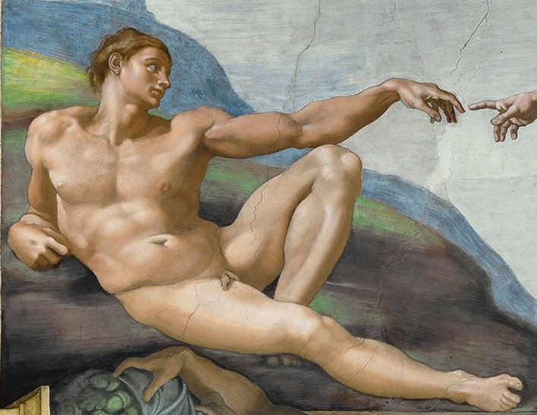
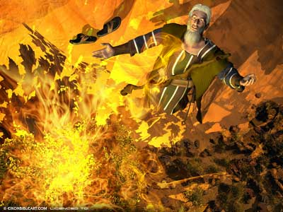
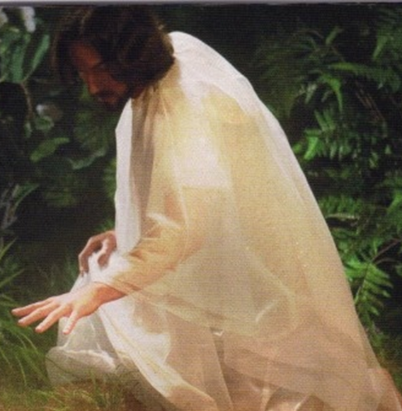
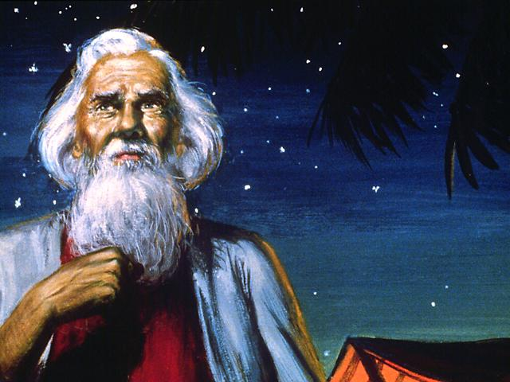
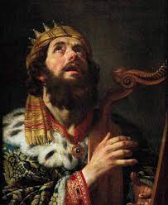
Five Guys Intimate with God
Adam
Moses
Jesus
Abram
David
Notes:
Amidst the hundreds of Biblical personalities in the Bible, five stand out as having a special relational position with their Creator:
Adam – God’s son (in that God provided his y-DNA)
Abram – God’s friend
Moses – God’s man and emissary
David – “a man after God’s own heart”
Jesus – the Son of God and Second Adam
All five had a real and unreligious relationship with God, unlike most or all of their contemporaries.

Slide 3
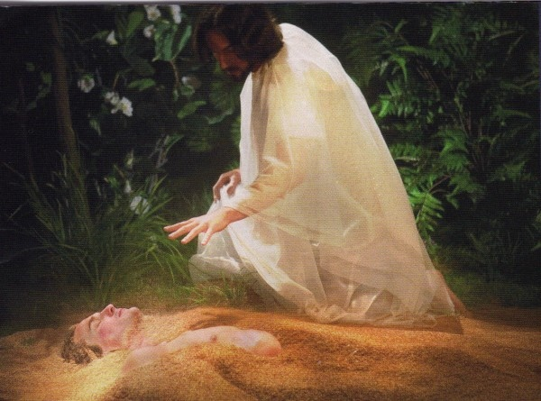
Adam: God’s Creation
Notes:
Pre-History
Creation. Garden of Eden. Adam (mankind) Introduce a single banana as Adam.
Perfect relationship

Slide 4
Relationship Broken
Guilt
Shame
Fear
Notes:
Broken by sin
Guilt, Shame and Fear replace relationship with God
Promise of complete restoration: “I will fix this!” – God
Adam, the man, becomes literally Mankind. One people/nation until Tower of Babel creates many nations.
Introduce bunch of bananas with one precut but skin still seemingly intact.

Slide 5
Abram: God’s Friend
2000 B.C.
Notes:
2000 B.C.
Abram.
Introduce a single banana cut as described above but separate from the bunch. This can be the Adam banana re-purposed if cut carefully.
Genesis 12: This septuagenarian Bedouin shepherd living in a tent outside Ur is called into a friendship with a covenant God. He is literally a new kind of banana and God tells him to mark that relationship in his skin. He becomes the first “cut-banana”. “Circumcise” the prepared Abraham banana.
God promises to bless Abram and make him into a nation (Abraham- Father of Nations) that will represent relation to God as the “Cut Banana People”. God initiates a friendship based on a promise, not any religion. It has nothing to do with Abraham’s behavior or works. It is pure GRACE and love.

Slide 6
Moses: God’s Man & Emissary
1500 B.C.
Notes:
1500 B.C
Moses was called into relationship by his Creator via a burning bush. Abraham’s descendants had become a large group but were not united, unaware of the Promise and enslaved in Egypt. Moses and God freed Israel from physical slavery but were unable to get the pagan shackles out of their minds. Moses had them cut their skin to make them a distinct banana among all the bananas.
Circumcise one of the bunched bananas.
Moses tried to introduce them to relationship with God. Israel completely rejected knowing God and after an attempt to make Him into an Egyptian Cow idol, in FEAR they refused his presence and demanded intermediaries (a priesthood) and a rules-based religion to manage their GUILT and SHAME.
They told Moses: “You speak to us. Not God!”
So God gave them what they wanted, rather than what He wanted.
Designed the Rules (Commandments) to prove that it couldn’t be done. There is just no saving yourself!
God’s sense of humor: Forbid the Cut-Banana People the most delicious meat in creation – bacon!

Slide 7
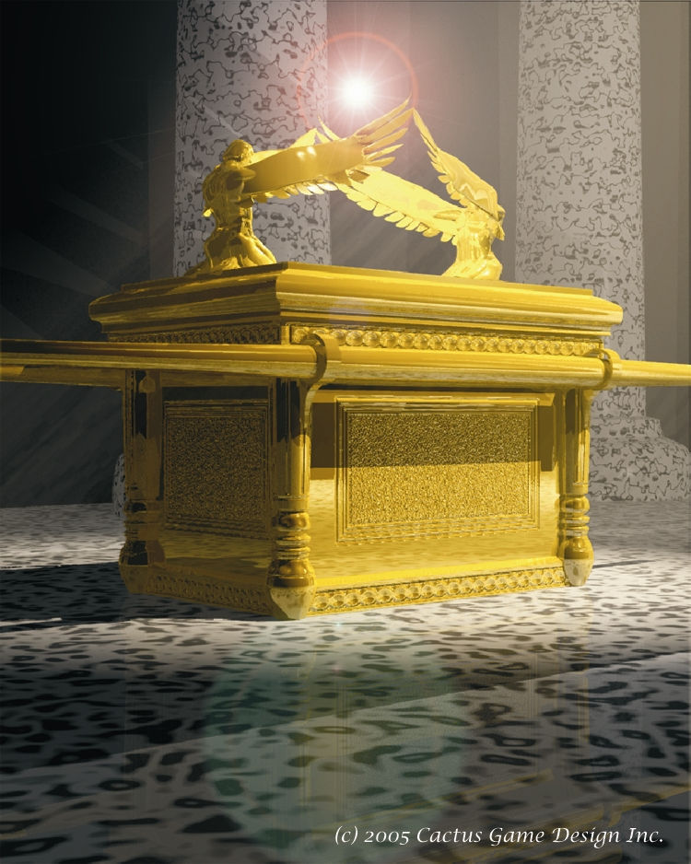
Ark of the Covenant
Notes:
The ark of the covenant. A wooden box overlaid with gold. Roughly a square meter box. [2.5 X 3 ft]
Tablets of Law inside and covered by the lid. The lid has a crown around it and is made of solid gold. It is topped with two cherubim – angelic beings with feathered wings. They face each other over the seat – the Mercy Seat (Cut-Bananaese: the Throne of Grace) That’s where the blood is spilled. Who sits on this ark? God does! It is the very place where God concentrates his presence. He is with them [Emmanuel] but without relationship.

Slide 8
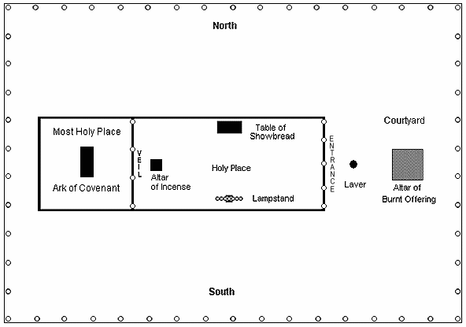
Tabernacle of Moses
Notes:
So He didn’t force himself on them. Holy of Holies. Unseen (except once a year by the high priest) behind a curtain in a tent within a tent. High Priest enters only once per year with blood on his hands, bells on his clothes, and a rope on his leg.
Time Passes – over 400 years
Eli is High Priest and his sons, Hophni and Phineas are the wicked clergy of the Cut-Bananas. They want to ensure victory in a battle against the neighboring uncut banana tribe and they run and drag out the Ark. “Now we have God leading the Army. We can’t lose”. Except the Cut-Bananas do lose – the ark, the High Priest’s stupid sons, 30,000 troops, and the war. The ark is taken off to the Gaza Strip as a war trophy where the victors stage a wild victory celebration. The Cut-Bananas think that their enemy has got God. Eli drops dead at the news. And there the Ark stays.
“And God forsook the Tabernacle of Moses at Shiloh and delivered His glory into the hands of Uncut-Bananas.”
Dagon, the fish god, ends up repeatedly worshipping on his face before the ark. Plagues and hemorrhoids break out. They pass it to another city and the same repeats.
They build a wooden cart and hitch it to cows and send it homeward. It comes to a Cut-Banana village – they rejoice wildly and throw a party. They break up the cart and burn the cows as a sacrifice. They put the ark on a rock and then they want to see how God is doing – so the open it.

Slide 9
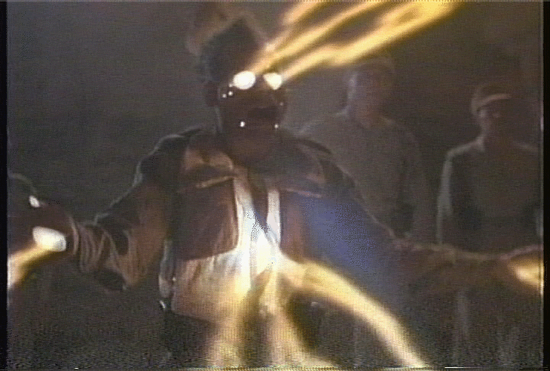
The Original Raiders of the Lost Ark
Notes:
It is Raiders of the Lost Ark! 70 men die.
Why? What is in the Ark? (broken tablets of the law)
What did they remove in order to expose the law? (mercy seat with the blood). God had covered the law with the mercy seat out of love and compassion. Removing that covering invoked the law without mercy – and that is when faces start to melt and folks burst into flames and explode.
The law kills!
They cart the ark off to a town of the Cut-Bananas called Kiriath Jearim where it stays for 20 years. Sitting in the house of a guy named Abinadab.
Samuel grows up and leads the Cut-Bananas as prophet and judge. Eventually the people demand a king and God graciously again gives them what they want - the king they deserve – Saul.
During this whole time the Tabernacle of Moses’ Tent (the Tabernacle of Moses) – empty of the presence of God, continues to function with clergy and religious programs: worship services, sacrifices, the whole shebang! Everything except God. At some point (we don’t know why – maybe for better satellite reception) they move it to a hill called Gibeon.
Nobody sought the Ark of God during the days of Saul. Nobody cared about having the presence of God.

Slide 10
David:
A man after God’s own Heart
1000 B.C.
Notes:
1000 B.C.
This was the passion of a young man named David. He wanted to bring the ark back and give it a place of honor. After he became king he sought to bring the ark to his new capital Jerusalem. He gets the people together – go out to Kiriath Jearim and build a wooden cart for the ark. This is a good thing right?
They are bringing the ark to Jerusalem and they are having a full blown Pentecostal worship jamboree along the road. The ark comes to a threshing floor – Do you know what happens at a threshing floor?
It is where the wheat and the chaff are separated.
The animals stumble and Uzzah, the son of Abinadab, reaches out to steady the ark – and is struck dead.
David is afraid – instantly reconsiders the plan to bring the ark home.
Why did God do this? You are not going to drag me around on something you built! David went back and did some research.
God had commanded that the ark be carried on two wooden poles stuck through two rings on either side of the ark. It was to be borne by sanctified men – God’s Creations! – not the devices of men.
How often do we expect to be able to drag God’s glory around with a man-made conveyance like a program, a building, a denomination, or whatever? This is a spiritually deadly activity.
David picked a hill in Jerusalem – ZION which is elevated above all the surrounding hills. And he decided to bring the Ark of God there. Zion was literally right behind his palace – David’s back yard.

Slide 11
I Chronicles 15 & 16
1 After David had constructed buildings for himself in the City of David, he prepared a place for the ark of God and pitched a tent for it.
1-2 They brought the ark of God and set it inside the tent that David had pitched for it, and they presented burnt offerings and fellowship offerings before God. After David had finished sacrificing the burnt offerings and fellowship offerings, he blessed the people in the name of the LORD.
Notes:
I Chronicles 15:1 After David had constructed buildings for himself in the City of David, he prepared a place for the ark of God and pitched a tent for it.
I Chronicles 16:1-2 They brought the ark of God and set it inside the tent that David had pitched for it, and they presented burnt offerings and fellowship offerings before God. After David had finished sacrificing the burnt offerings and fellowship offerings, he blessed the people in the name of the LORD.

Slide 12
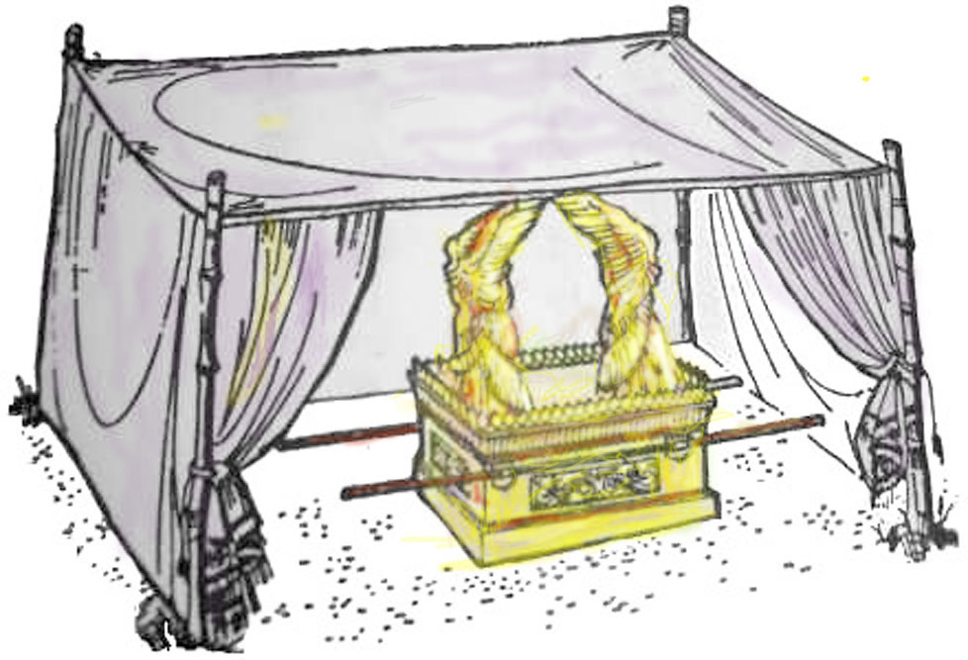
Tabernacle of David
Notes:
He “prepared a place” for God – a small simple canvas tent.
This time all the sanctified Levites bring the ark. All the people are unified and praising. David strips down to priestly underwear and dances before the ark as it goes up Zion. This is the highest moment of David’s life. The most wonderful manifestation of God with his people since Eden.
Two Tabernacles
So we have two tabernacles at the same time.
Mt. Gibeon – priests are leading sacrifices and slinging blood and the brazen altar, passing out the bulletins, holding regular worship services and special ones for holidays, going through all of the rituals perfectly, except for one thing. There is no ark, The presence of God has been gone for ages.
Does this bother them? Oh no!
RELIGION is the only business that can be out of business and still be in business.
They are fulfilling what they understand to be their religious obligations and keeping their careers afloat.
And the Cut-Banana People can’t see that the Holy of Holies is bare and empty because the veil is closed and the main court is far off.
Only SIX MILES AWAY on another hill we got a cult!
Mt. Zion:
Pandemonium. People are singing, playing instruments, dancing, worshipping loudly and wildly. In freedom. The ark is there and it is unveiled! Not just for the priests but for everyone! Face to face, intimacy with God and no one is dying!
There are no blood sacrifices on Mt. Zion. One on the day of dedication and never again. The worship and singing went on 24 hours a day, on the hour, for 40 years!
“who stand by night, in the house of the Lord”? That’s the night shift of worshippers.
What is this? This is the New Covenant right smack dab in the middle of the Old Testament. For the first time since the Garden, God is face-to-face with His people – unveiled!

Slide 13
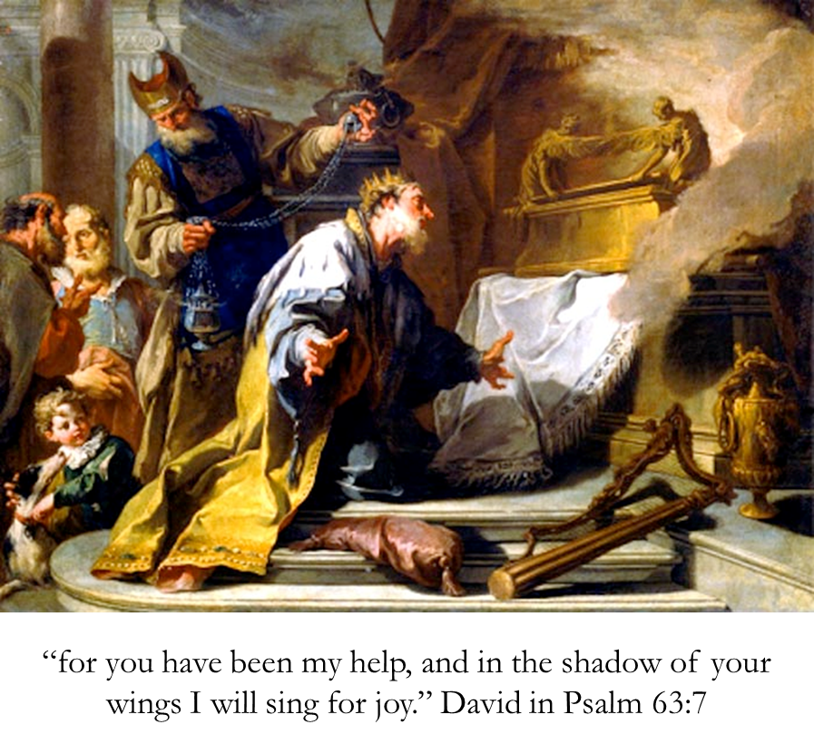
Notes:
David nestled right up next to the ark under the shadow of the wings of those cherubim?
He pulls out his pen and writes:
“He that dwells in the secret place of the Most High shall abide under the shadow of the Almighty”
You hafta be close to something to be under its shadow.
So many of your Psalms were written right inside David’s tent!
“I will dwell in your tabernacle all the days of my life and I will trust in the covering of your wings”
All those passages about Zion that we sing. Why? Because God is there.
God’s people were all functioning as priests in David’s tabernacle.
“You have come to Mt. Zion” in Jesus Christ. Liberty, freedom joy and an experience of God’s presence.
Mount Gibeon – just religion and ritual.

Slide 14
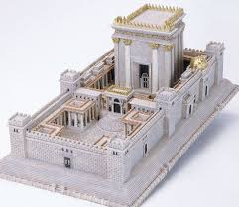
The Temple
Notes:
Sadly, David’s son Solomon builds a stone temple to replace Moses’ Tent and David’s tent is swept away and replaced by a new Holy of Holies and the Ark disappears again.
500 B.C.
God speaks to a Cut-Banana prophet named Amos, and makes an amazing promise. Apparently God enjoyed the intimacy of His friend David’s tent.

Slide 15
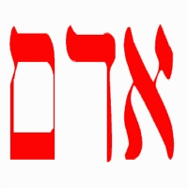
Amos 9:11-12
"In that day I will restore David's fallen tent.
I will repair its broken places, restore its ruins, and build it as it used to be
so that they may possess
the remnant of Adam (mankind)
and all the nations that bear my name,"
declares the LORD, who will do these things.
500 B.C.
Notes:
9:11-12 "In that day I will restore David's fallen tent.
I will repair its broken places, restore its ruins,
and build it as it used to be, so that they may possess the remnant of Adam (Mankind)
and all the nations that bear my name," declares the LORD, who will do these things.

Slide 16
Jesus: God With Us
I will fix this!
4 B.C. ~ 33 A.D.
Notes:
500 years after Amos’ Prophesy (4 B.C. to 33 A.D.)
God keeps his Genesis 3 promise to Adam and His Genesis 12 Covenant to Abraham in JESUS
I WILL FIX THIS!
Jesus is God’s son like Adam (no human father – paternal DNA created and implanted by God Himself) and He is called the Second Adam. This is literally Mankind REBOOTED!
Jesus fixed the problem of relational loss and separation – the sin problem – by carrying ALL the sin and brokenness in His sinless life, body and blood and pouring them out willingly – destroying sin and restoring all that the First Adam had thrown away.
Jesus was a Cut Banana from his 8th day on the planet.
ALL of Jesus’ followers were Cut Bananas. They thought him to be the promised Cut-Banana Messiah.
Religious leaders had Jesus executed. The actual death sentence was for the charge of saying he’d destroy the Temple.

Slide 17
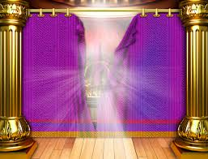
Torn Curtain
Notes:
When Jesus died, God expressed His opinion of the separation represented by the Holy of Holies – the curtain tore from top to bottom. Exposing an empty room devoid of ark or presence.
After Pentecost they gathered around a kosher dinner table to have real intimate relationship with God and one-another. They were God’s Family and filled with His Spirit!
Then something disturbing began to happen . . . First Peter, and later Barnabus and Paul began to bring many regular uncut bananas into relationship with God. God sealed His acceptance of these unclean outsiders by putting His Spirit into them – just as He had the first believers on Pentecost.
This breaks all the rules! Cut Bananas may not ever even be in the home of Uncut Bananas – much less eat their food or sit at table with them! There is no way that God expects them to fellowship in the same house churches.

Slide 18
The Council at Jerusalem
ACTS 15:1-2 NBSV (New Banana Standard Version)
Some men came down from Judea to Antioch and were teaching the Uncut Banana brothers: "Unless you are cut, according to our religious rules, you cannot be saved."
This brought Paul and Barnabas into sharp dispute and debate with them. So Paul and Barnabas were appointed, along with some other believers, to go up to Jerusalem to see the apostles and elders about this question.
Notes:
Acts 15 (50 A.D.)
The Council of Jerusalem.
The situation had reached the boiling point with a banana cutting faction following Paul around and trying to insist the Uncut Believers get, well . . . cut.
ACTS 15:1-2 NBSV (New Banana Standard Version)
Some men came down from Judea to Antioch and were teaching the Uncut Banana brothers: "Unless you are cut, according to our religious rules, you cannot be saved."
This brought Paul and Barnabas into sharp dispute and debate with them. So Paul and Barnabas were appointed, along with some other believers, to go up to Jerusalem to see the apostles and elders about this question.
James, Jesus’ half-brother, was leader of the Jerusalem Mother Church. James is a Bible Scholar and is zealous for the Law (especially the special banana skin reduction provision).

Slide 19
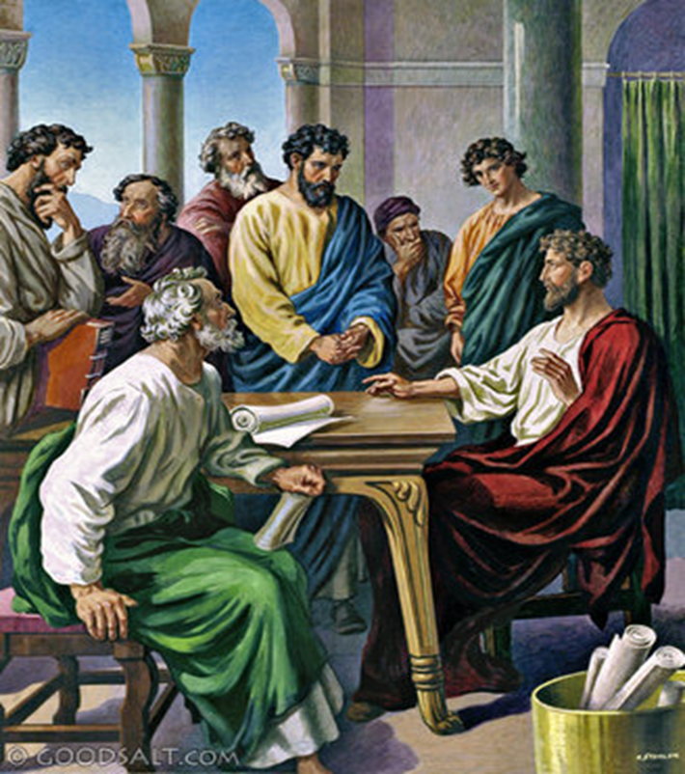
The Council at Jerusalem
50 A.D.
Notes:
The leaders of Jesus’ Ecclesia meet in Jerusalem to decide the issue.
THE PROBLEM

Slide 20
The Council at Jerusalem
ACTS 15:5-6
Then some of the particularly rigid Cut Banana believers stood up and said, "Those from Uncut Banana nations must be cut and required to obey the law of Moses."
The apostles and elders met to consider this question.
Notes:
ACTS 15:5-6
Then some of the particularly rigid Cut Banana believers stood up and said, "Those from Uncut Banana nations must be cut and required to obey the law of Moses."
The apostles and elders met to consider this question.
Witnesses are called:

Slide 21
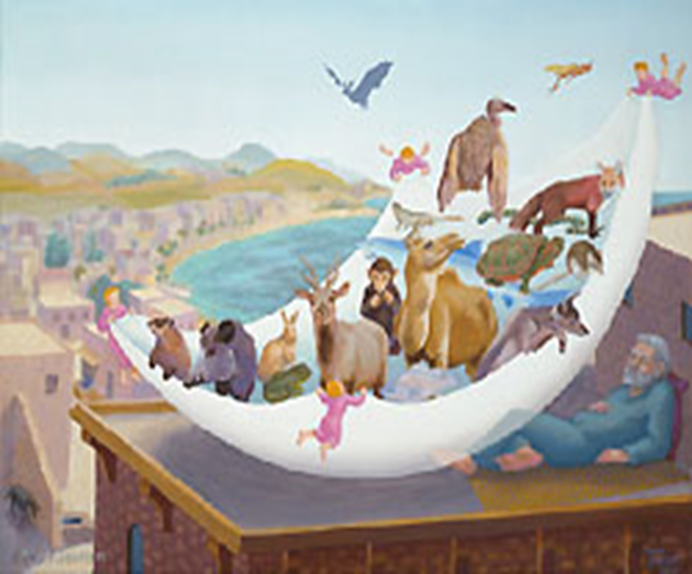
Peter
Notes:
Peter: tells again of his rooftop revelation “Who are you to call unclean what I have declared clean”

Slide 22
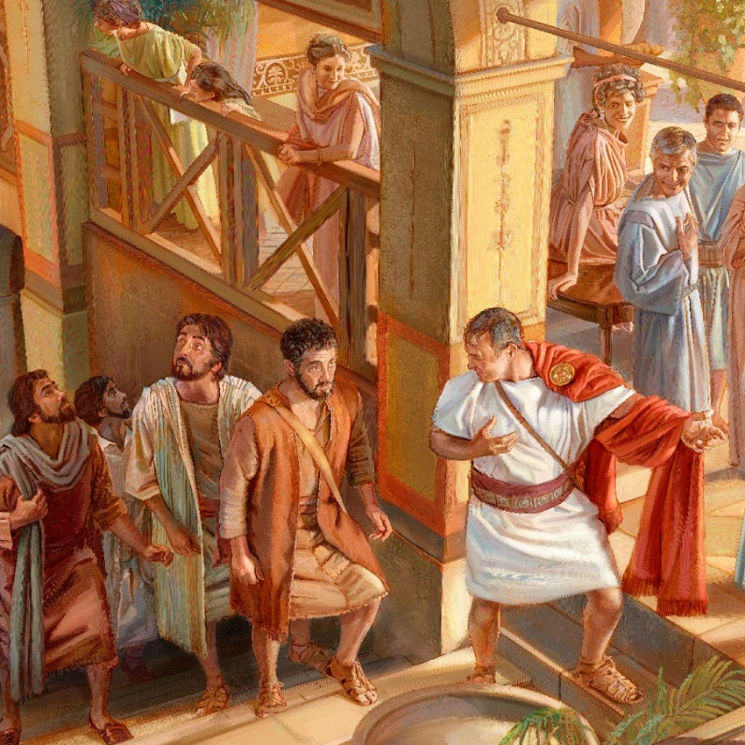
Peter eats with Uncut Bananas from Rome!
Notes:
and the response of a bunch of Uncut Bananas immediately following. Spirit filled Uncuts!
“We are saved by grace, and so are they!”

Slide 23
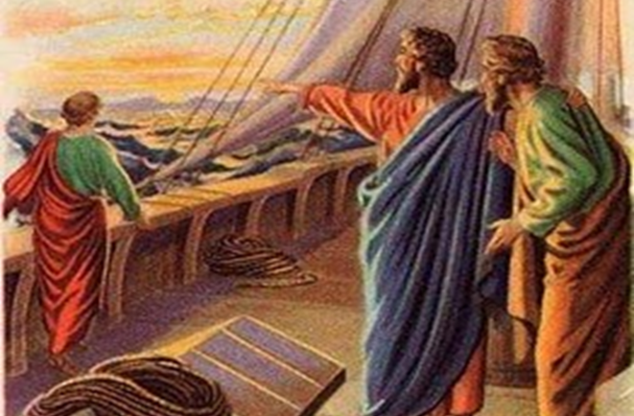
Paul and Barnabus start DMMs among Uncut Bananas
Notes:
Paul and Barnabus: share numerous accounts of a number of believers from among many Uncut Banana nations, who also received God’s Spirit and intimate relationship with God. No cutting or other religious laws were imposed and God didn’t seem to care!
James is hearing all this and thinking God is breaking all His own rules letting these unclean and uncut bananas into His presence.
Then he remembers Amos’ 500-year-old prophesy.
DAVID’S FALLEN TENT – The Ark without covering. This is not the first time God threw out the RULES.

Slide 24
The Decision
13 When they finished, James spoke up: "Brothers, listen to me.
14 Simon has described to us how God at first showed his concern by taking from the Uncut Bananas a people for himself.
15 The words of the prophets are in agreement with this, as it is written:
Notes:
13 When they finished, James spoke up: "Brothers, listen to me.
14 Simon has described to us how God at first showed his concern by taking from the Uncut Bananas a people for himself.
15 The words of the prophets are in agreement with this, as it is written:

Slide 25
The Decision
16-18 " 'After this I will return and rebuild David's fallen tent. Its ruins I will rebuild,
and I will restore it, that the remnant of men may seek the Lord, and all the Uncut Bananas who bear my name, says the Lord, who does these things’ that have been known for ages.
19 "It is my judgment, therefore, that we should not make it difficult for these Uncut Bananas who are turning to God.
Notes:
16-18 " 'After this I will return and rebuild David's fallen tent. Its ruins I will rebuild,
and I will restore it, that the remnant of men may seek the Lord, and all the Uncut Bananas who bear my name, says the Lord, who does these things’ that have been known for ages.
19 "It is my judgment, therefore, that we should not make it difficult for these Uncut Bananas who are turning to God.
The Jerusalem Council concluded that no religious barriers would bar the way for Uncut Bananas who desired relationship with their Creator through Jesus Christ. They wrote to the Uncut Banana churches and invited them to share table fellowship with Cut Banana believers (as long as they promised not to serve a few of the most culturally difficult menu items --- strangled meat, blood sausage, repurposed pagan sacrificial meat. They also told them to observe proper table manners – no orgies!).
This is when the GOSPEL was set free from Religious Chains. God was finally getting what He’s wanted since Eden – relationship with his human children – all of them.

Slide 26
Which Will It Be?
RELIGION
RELATIONSHIP
Rules carved on stone
Go-betweens and Priests
Obligation
Earn salvation
Behavior-based
Sin Management System
Written on hearts
Royal Priesthood with Direct Contact
Joy
Salvation a gift
Grace-based
Brand New Life with Guilt and Shame nailed to the Cross
Notes:
Let’s contrast:
RELIGION RELATIONSHIP
Rules Carved on stone Written on hearts
Go-betweens and Priests Royal Priesthood with Direct Contact
Obligation Joy
Earn salvation Salvation a free gift.
Behavior-based Grace-based
Sin Management System New Life – New person. G&S on Cross

Slide 27
Which Will It Be?
RELIGION
RELATIONSHIP
Distance from God
Responsibilities
“Should” & “Shalt Not”
External & Cultural
God’s Presence Veiled
Fear
Re-ligere (Latin): to bind again tightly
Intimacy with God
An Ability to Respond
Invitation & Opportunity
Internal & Universal
Face-to-Face
Perfect Love
Whom the Son sets free is free indeed!
Notes:
Distance from God Intimacy with God
Responsibilities Ability to Respond
“Should” & “Shalt Not” Invitation & Opportunity
External Internal
Human Culture Universal
Presence of God Veiled Face-to-Face
Fear Perfect Love
Re-ligare – to bind again tightly Whom the Son sets free is free indeed

Slide 28
Notes:
If like those Cut Bananas at Mount Sinai you want distance and separation from God in the form of religion, sacrifices and priests – then okay . . . God will let you have it your way, and religious choices abound in this city. Even Christian Religion.
But if you want PERFECT LOVE and INTIMATE RELATIONSHIP with your Creator – as a precious daughter or son – It is yours for the asking. The Law is no more. Jesus nailed it to the cross.
There is no barrier. God fixed it! It matters nothing if your banana is CUT or UNCUT.
God has been looking forward to hanging out with you from the very beginning. Don’t make Him wait another minute.
Let’s pray!

Slide 29
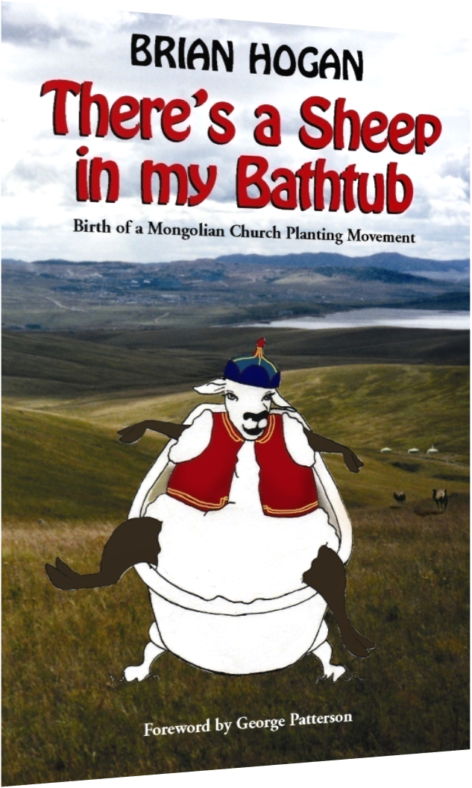
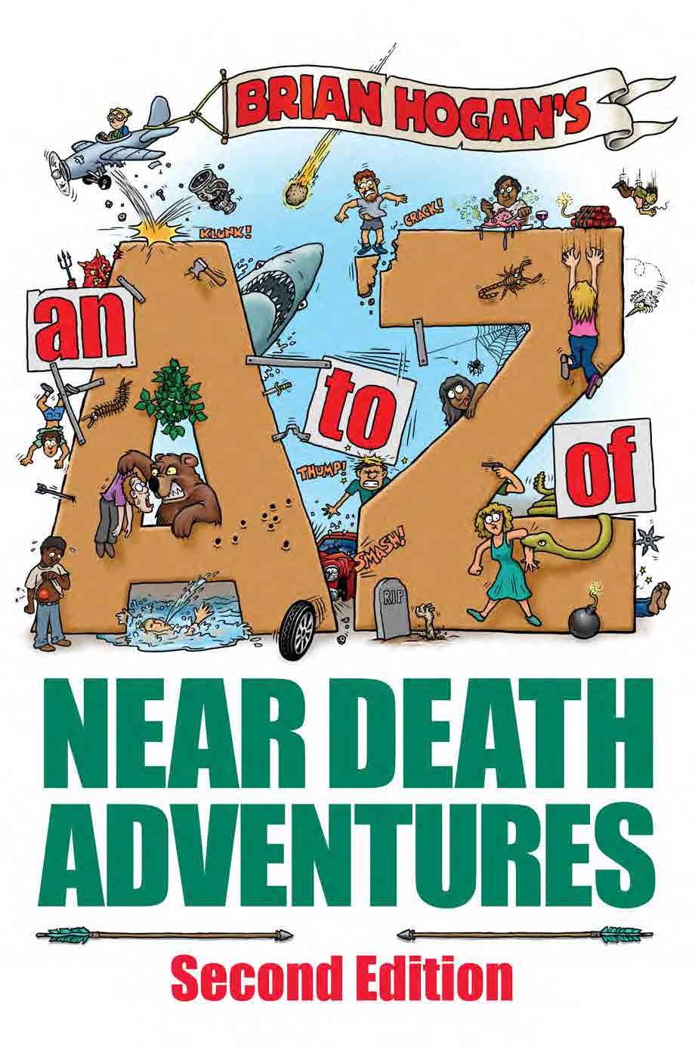
Brian’s books available with
FREE SHIPPING TO SOUTH AFRICA
at: http://www.bookdepository.com
R 194.93
R 213.38
Also in E-Book Format for Kindle, Nook, ect.

